Slide 1
Securing data share using encryption technique in the context of cloud computing
Presented by:
Name Roll no
Shadab khan 15CMPN23
Ankita Taradale 15CMPN53
Mayuri Waghamode 15CMPN59
Deepal Shinde 14CMPN10
Swaliha Momin 13CMPN34
Under the Guidance : Prof.Mrs.Darbastwar

Slide 2
Contents
Introduction
Literature review
Problem statement
Objectives
Proposed work
System architecture
Methodology and Implementation

Slide 3
Introduction
The concept of cloud computing envolved in 1950(IBM), in 2006 Amazon provided 1st public cloud AWS(Amazon web service)
Cloud computing is a type of Internet-based computing that provides shared computer processing resources and data to computers and other devices on demand.
For secure data sharing in cloud cipher text policy attribute based encryption is promising because data owner having full control over access policy of shared data.
In CP-ABE having a key escrow problem whereby the secret keys of users have to be issued by a trusted key authority.

Slide 4
As the cloud computing technology develop during the last decade, outsourcing data to cloud service for storage becomes an attractive trend, which benefits in sparing efforts on heavy data maintenance and management.
The cloud service providers and key authority are not fully trustworthy, it raises security concerns on encrypting data and key management in cloud also key escrow problem occurs.

Slide 5
Literature review
In 2005,Sahai and Waters introduced fuzzy identity based encryption(IBE),which is the seminal work of attribute based encryption(ABE). After that,two variants of ABE were proposed: key policy ABE (KP-ABE) and CP-ABE,depending on if a given policy is associated with either a ciphertext and a key. Later,many CP-ABE schemes with specific features have been presented in the literature.
In 2013,provided an improved security data sharing scheme based on the classic CP-ABE. The key escrow issue is addressed by using an escrow-free key issuing protocol where the key generation center and the data storage center work together to generate secret key for user.

Slide 6
Problem Statement
To develop CP-ABE data sharing scheme having a key escrow problem in cloud environment.

Slide 7
Objectives
To improve expressiveness of attribute for improving access policy by implementing attribute with weight.
To implement two-party key issuing protocol to avoid cloud service providers to use master secret
To enhance data confidentiality and privacy in cloud system against the managers of KA and cloud service providers as well as malicious system outsiders.

Slide 8
Proposed Work
1. To Avoid Cloud Provider’s Key Authority to decrypt the data file shared on the Cloud with Master Key, as Key Authority known master key of user and they are not fully trusted.
2. To improve expressiveness of attribute for improving access policy by implementing attribute with weight.
3. To secure data in Cloud from hacker or the unauthorized user, To Implement the Key and unique attributes based Encryption and Key Matching Process from Both Data Owner and Particular Authorized User.

Slide 9
To solve the key escrow problem in cipher text attribute base encryption due to semi trusted key authority. As key authority known master key of user it can escrow key or also can decrypt all files of user. So key authority should not be fully trusted.
To provide secure and efficient data sharing in cloud with proper key management and effective attributes. Secure key management can be done by solving key escrow by converting fully trusted key authority into semi trusted.

Slide 10
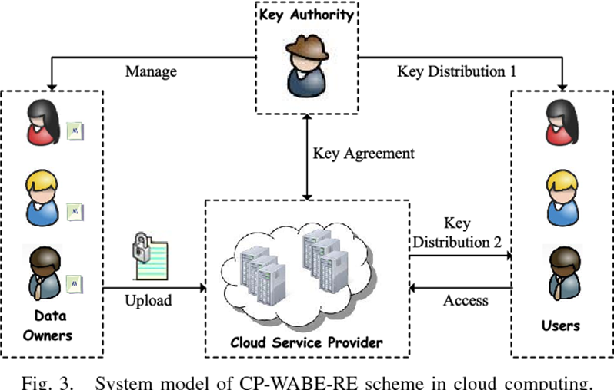
System architecture

Slide 11
Cloud Clients
Cloud Clients have large data ﬁles to be stored and rely on the cloud for data maintenance and computation. They can be either individual consumers or commercial organizations and they need security over data stored o cloud.
Cloud Servers
Cloud Servers virtualize the resources according to the requirements of clients and expose them as storage pools. Typically, the cloud clients may buy or lease storage capacity from cloud servers, and store their individual data in these bought or rented spaces for future utilization. also provides a key to user for downloading of file.
Key Authority:
Key authority is semi trusted person and responsible for assigning a key to user for uploading but they only know a part of that key. So they cannot know key of users for decrypting a file.

Slide 12
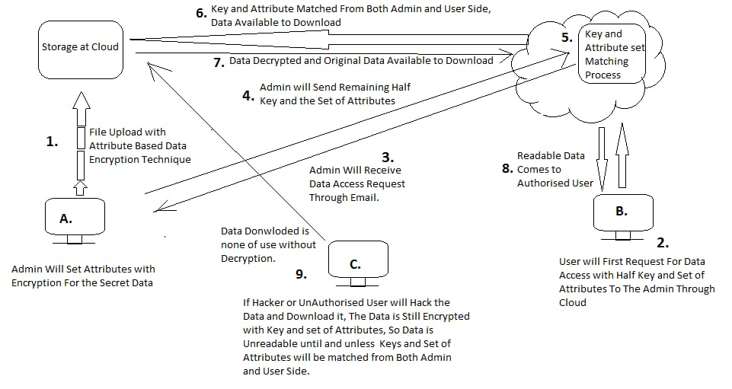
Methodology and Implementation

Slide 13
Phase 1: System Initialization. This phase includes both algorithms: KA.Setup and CSP.Setup.
KA Setup: KA.Setup(1κ) → (PP1,MSK1).
Encryption key(SK)=MSK1+MSK2
CSP.Setup(1κ) → (PP2,MSK2). This algorithm is
run by CSP.
The public parameter and master secret key of system are
denoted as PP = {PP1,PP2} and MSK = {MSK1,MSK2},
where MSK1 and MSK2 are stored by KA and CSP.
Phase 2 : Data Encryption -DO first encrypts file M with content key ck
by using simple symmetric encryption algorithm, where file
ciphertext is denoted as Eck(M).
DO.Encrypt(PP, ck,A) → (CT).

Slide 14
Phase 3 : User Key Generation. This phase consists
of KA.KeyGen and CSP.KeyGen.
KA.KeyGen(MSK1, S) → (SK1).
In CSP.KeyGen, we propose an improved two-party key issuing protocol to remove escrow. KA and CSP perform the improved protocol with master secret keys of their own.
CSP.KeyGen(MSK2) → (SK2).
KeyComKA↔CSP(MSK1, IDt, r,MSK2) → (SK2).
It is an interactive algorithm between KA and CSP.
SK = {SK1,SK2}.
Phase 4 : Data Decryption. This phase contains both
algorithms: Users.Decrypt and Data.Decrypt.
Users.Decrypt(PP,SK, CT) → (ck).
Data.Decrypt(Eck(M), ck) → (M). User inputs
Eck(M) and ck. Based on symmetric decryption algorithm,
it outputs file M.

Slide 15
Modules
Data owner registration-Data owner have to register the details and then select data. Encrypts the key by data owner. DO encrypt shared data files and store them in the cloud.
Attribute management-DO selects attribute and encrypts the key and the encrypted data is transferred to CSP.
User authorization-User sends request to DO. After this attributes are match along with the key of DO and user.
User access-If it is authorized user then the file is accessed which is in decrypted format. Access policies are expressed in the terms of set of attributes. The user obtains the data file by using key to decrypt the CP of data file.

Slide 16
Input and Output
Inputs to Upload Files:
User Name and Password to Login Dashboard.
Files to be secured on Cloud Space.
Request Key to Key Authority.
Data Encrypted with Key.
Key Agreement between Key Authority and Cloud Service Provider
Data User Request to Access the file, this request in terms of Key to Access to both CSP and KA.
Output:
Key Matching Process (Decryption)
Access to Expected Files
Downloaded File in Readable Format( Decrypted File)

Slide 17
Application
It is used in militaries and governments to facilitate secret communications.
It is also used to protect data in transit for example data being transferred via networks,wireless intercom system.
It is used in cyber security to secure confidential data .

Slide 18
Thank you!

